Slide 1

Machine Learning
Dr. Anand Kakarla
Jan-May 2025

Slide 2
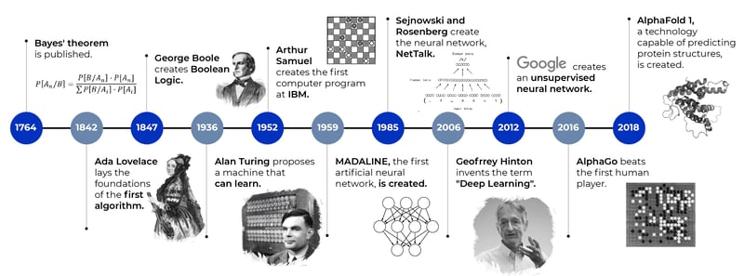
ML Evolution
Machine Learning (ML) was conceptualized over 70 years ago
Recent popularity due to compute power and availability of data

Slide 3
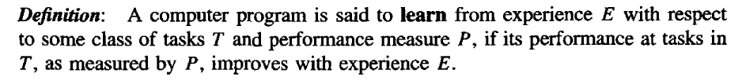
Learning: Formal definition

Slide 4
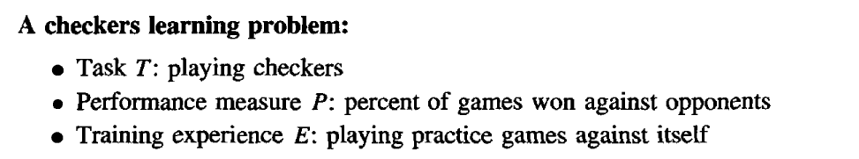
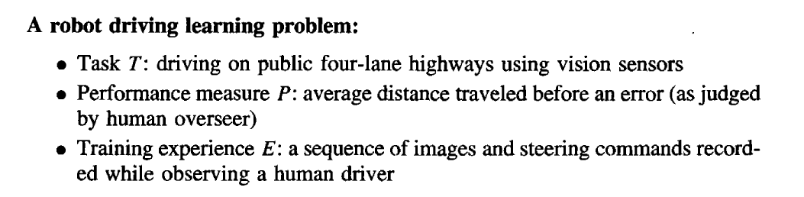
Example

Slide 5
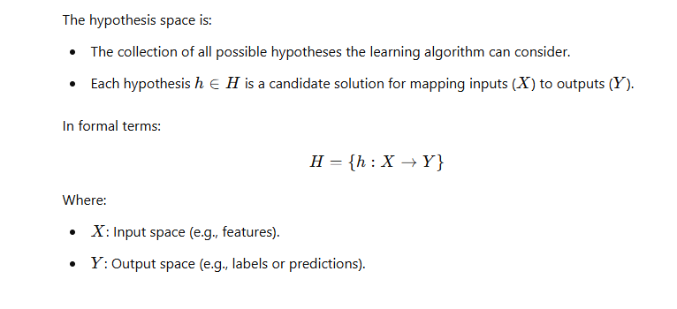
Hypothesis space

Slide 6
Learning Categories
Tasks
Classification
Regression
Clustering
Dimensionality reduction
Ranking
Paradigms
Supervised Learning
Unsupervised Learning
Semi-supervised Learning
Reinforced Learning
Transfer Learning
Online Learning

Slide 7
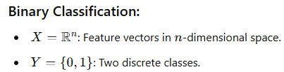
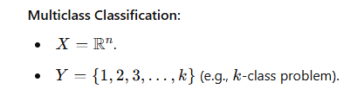
Classification
Classifying data into discrete classes or categories.
Goal: Predict a categorical label based on input features.
A function $f: X→Y$where Y is discrete. Here, X is the input space, and Y is the output space containing a finite set of discrete values (classes or categories).

Slide 8
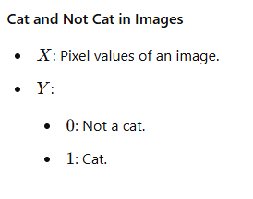
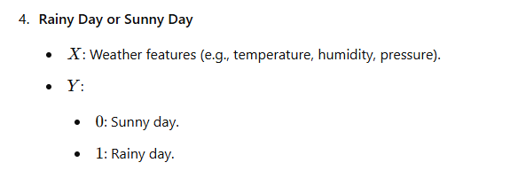
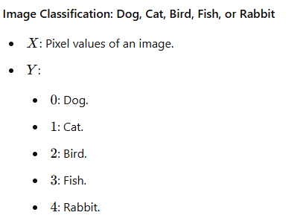
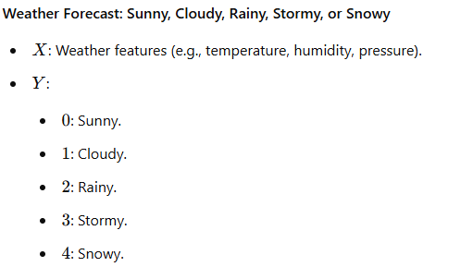
Classification: Examples
Binary Class
Multi-class

Slide 9
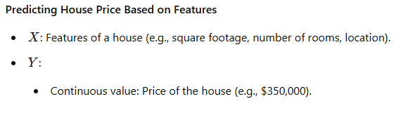
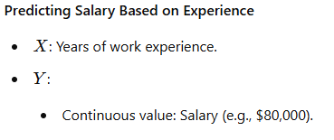

Regression
Predicting continuous values based on input features.
Goal: Estimate a real-valued output : $f: X→Y$where Y is continuous.

Slide 10
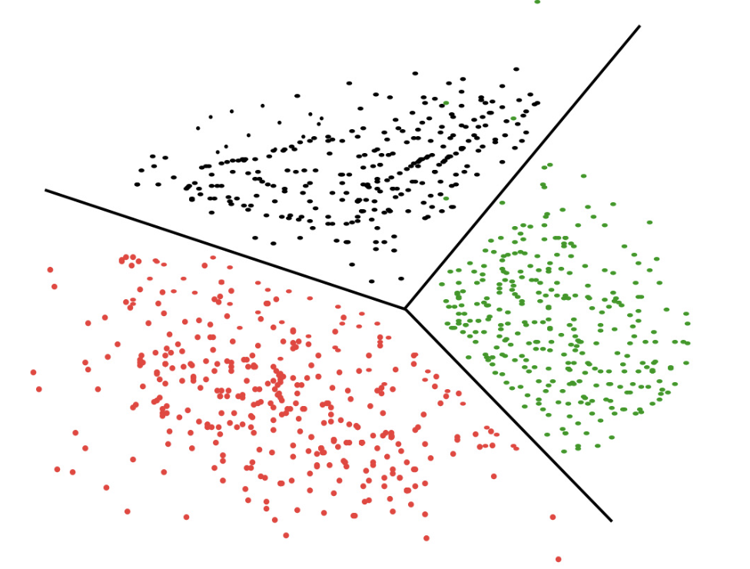
Clustering
Definition: Grouping data into clusters where similar data points are in the same group.
Goal: Discover inherent structures or patterns in unlabeled data.
Examples:
Customer segmentation in marketing
Document clustering

Slide 11
Learning Scenarios

Slide 12
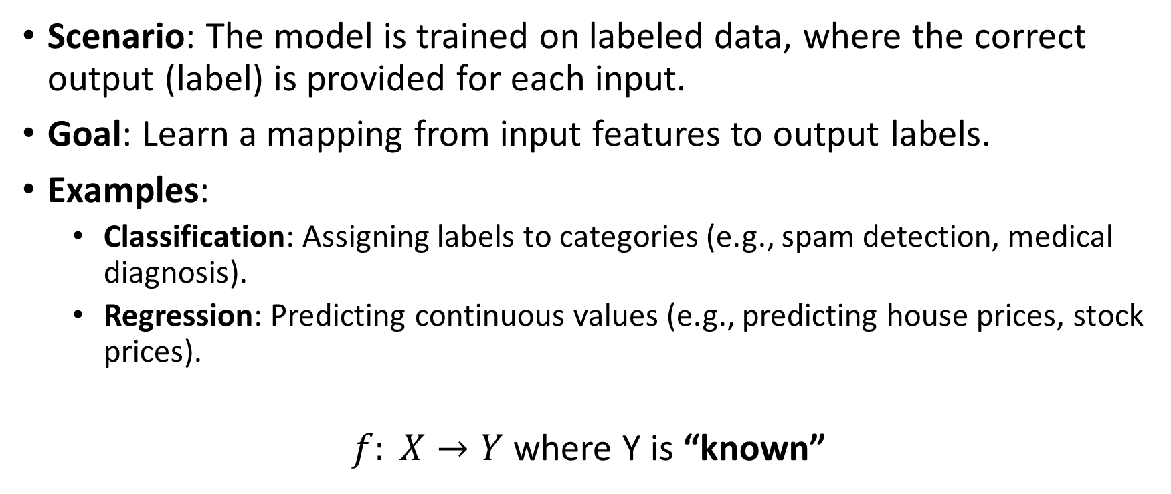
Supervised Learning
Scenario: The model is trained on labeled data, where the correct output (label) is provided for each input.
Goal: Learn a mapping from input features to output labels.
Examples:
Classification: Assigning labels to categories (e.g., spam detection, medical diagnosis).
Regression: Predicting continuous values (e.g., predicting house prices, stock prices).
$f: X→Y$where Y is “known”

Slide 13
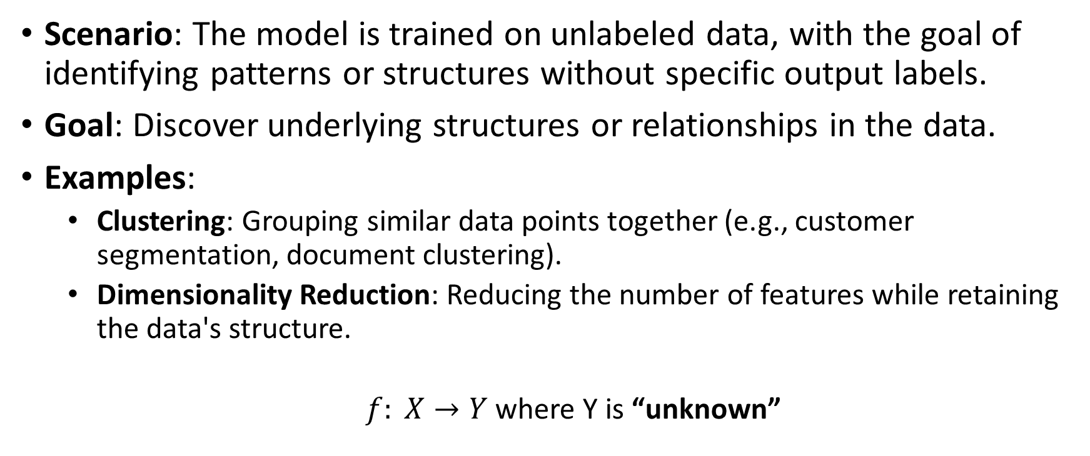
Unsupervised Learning
Scenario: The model is trained on unlabeled data, with the goal of identifying patterns or structures without specific output labels.
Goal: Discover underlying structures or relationships in the data.
Examples:
Clustering: Grouping similar data points together (e.g., customer segmentation, document clustering).
Dimensionality Reduction: Reducing the number of features while retaining the data's structure.
$f: X→Y$where Y is “unknown”

Slide 14
Semi-supervised Learning
Scenario: The model is trained on a small amount of labeled data and a large amount of unlabeled data.
Goal: Leverage the structure of the unlabeled data to improve learning from the limited labeled data.
Examples:
Using a small number of labeled images to classify a large set of unlabeled images.
Semi-supervised learning can be especially useful when labeled data is scarce or expensive to acquire.

Slide 15
Reinforcement Learning (RL)
Scenario: The model learns through trial and error, receiving feedback (rewards or penalties) from the environment.
Goal: Maximize cumulative reward by learning optimal actions over time.
Examples:
Games: AI playing games like chess, Go, or video games.
Robotics: Learning to control robots for tasks like navigation or manipulation.

Slide 16
Transfer Learning
Scenario: The model is pre-trained on a large dataset and then fine-tuned on a smaller, related dataset.
Goal: Transfer knowledge gained from one task to another, often in cases where labeled data for the new task is limited.
Examples:
Using a model pre-trained on ImageNet for a specific image classification task.
Fine-tuning a language model for a specific NLP task (e.g., sentiment analysis).

Slide 17
Online Learning
Definition: A machine learning scenario where the model is updated incrementally as new data arrives, rather than training on the entire dataset at once.
Key Characteristic: Continuous updates after processing each data point (or small batch of data).
Applications of Online Learning
Recommendation Systems: Real-time user preferences for personalized content.
Fraud Detection: Continuously learning from incoming transaction data.

Slide 18
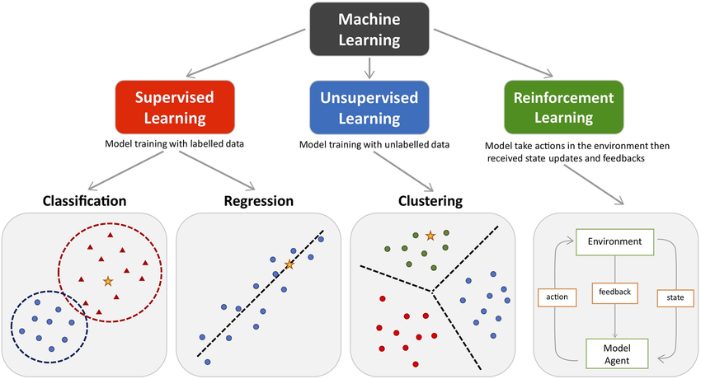
All in one

Slide 19
Designing a learning system
Choosing the Training Experience
Choosing the Target Function
Choosing a Representation for the Target Function
Choosing a Function Approximation Algorithm

Slide 20
Designing a Learning system
Task: Predicting House Prices
Choosing the Training Experience:
Data: Historical data of house prices, including features like the number of bedrooms, bathrooms, square footage, location, age of the house, etc.
Experience: The model learns from this data by identifying patterns and relationships between the features and the house prices.

Slide 21
Designing a Learning system
Choosing the Target Function:
Definition: The target function, often denoted as ( f(x) ), maps the input features (e.g., number of bedrooms, square footage) to the output (house price).
Objective: To predict the price of a house given its features.

Slide 22
Designing a Learning system
Representation of Target Function:
Model: Choosing the type of model.
Example: Whether to use a linear or nonlinear model

Slide 23
Designing a Learning system
Choosing the function approximation
Choosing the optimization framework for function approximation by minimizing the error between the predicted prices and the actual prices in the training data

Slide 24
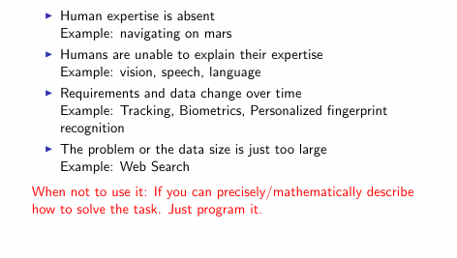
When not to use

Slide 25
Issues in Learning
Some hard ML problems include:
1. High-dimensional data (e.g., genomics, images)
2. Small data or insufficient labeled data
3. Highly unbalanced classes
4. Noisy or incomplete data

Slide 26
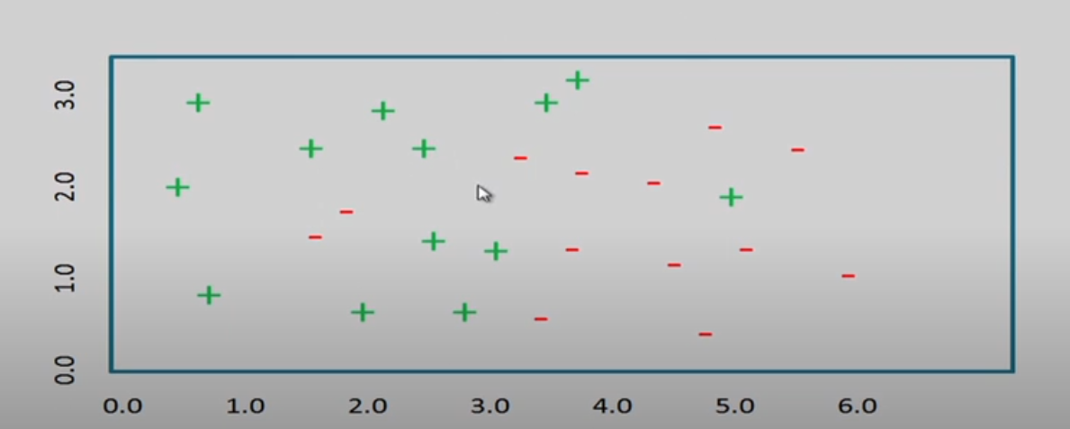
Induction Bias

Slide 27
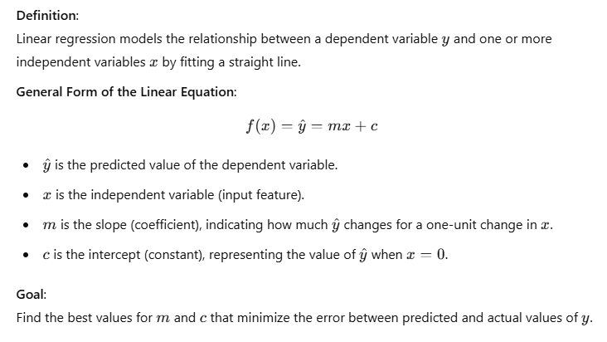
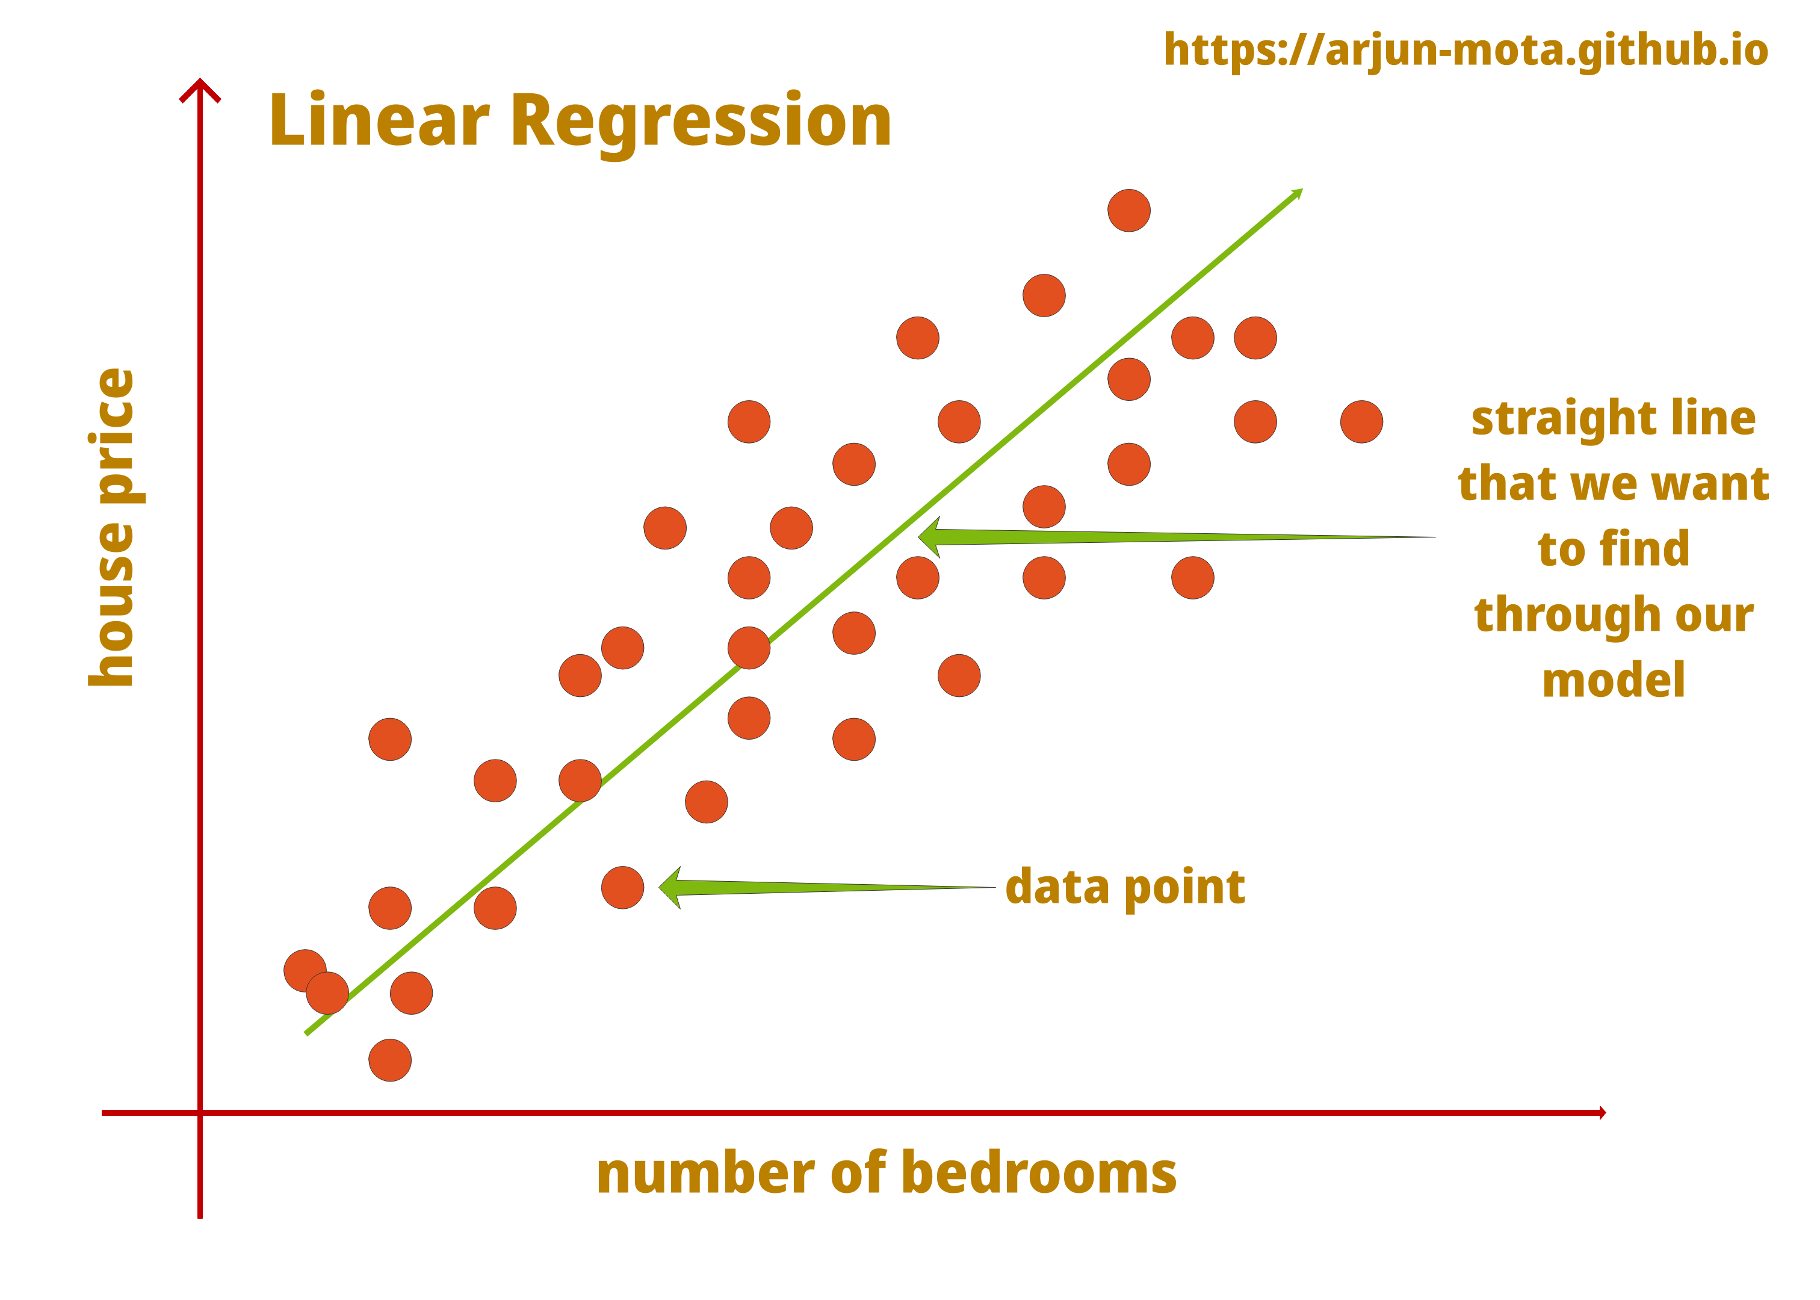
Linear Regression (trivial method)

Slide 28
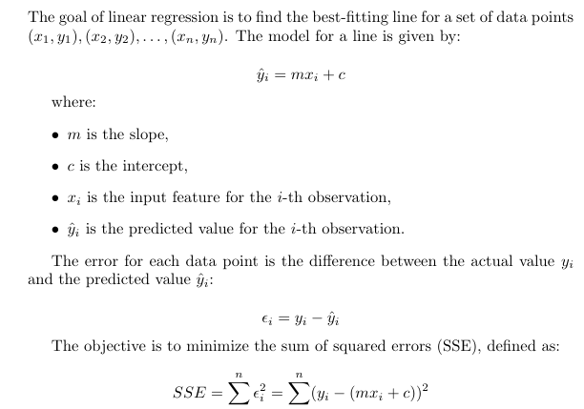
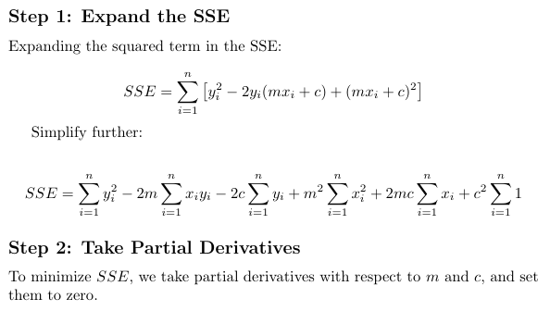
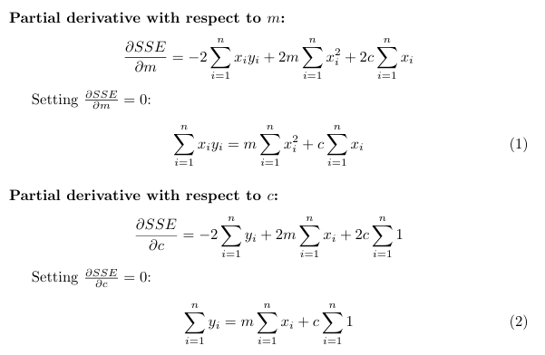
Unit 2: Linear Regression
Note: This slide is Not included in the exam (only for reference)

Slide 29
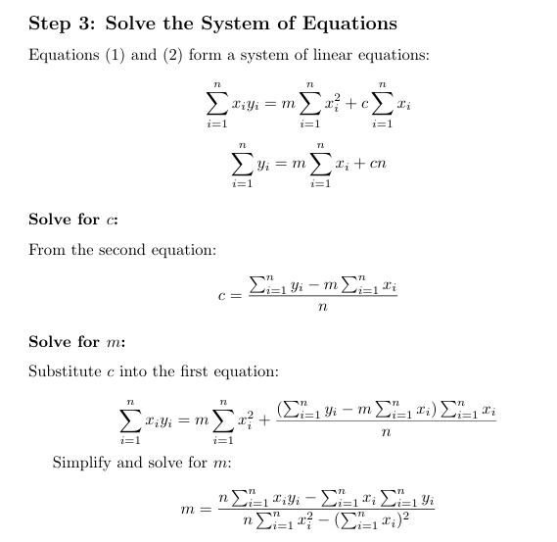
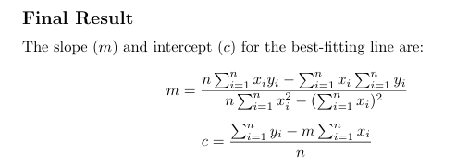
Linear Regression (trivial method)
Note: This slide is Not included in the exam (only for reference)

Slide 30
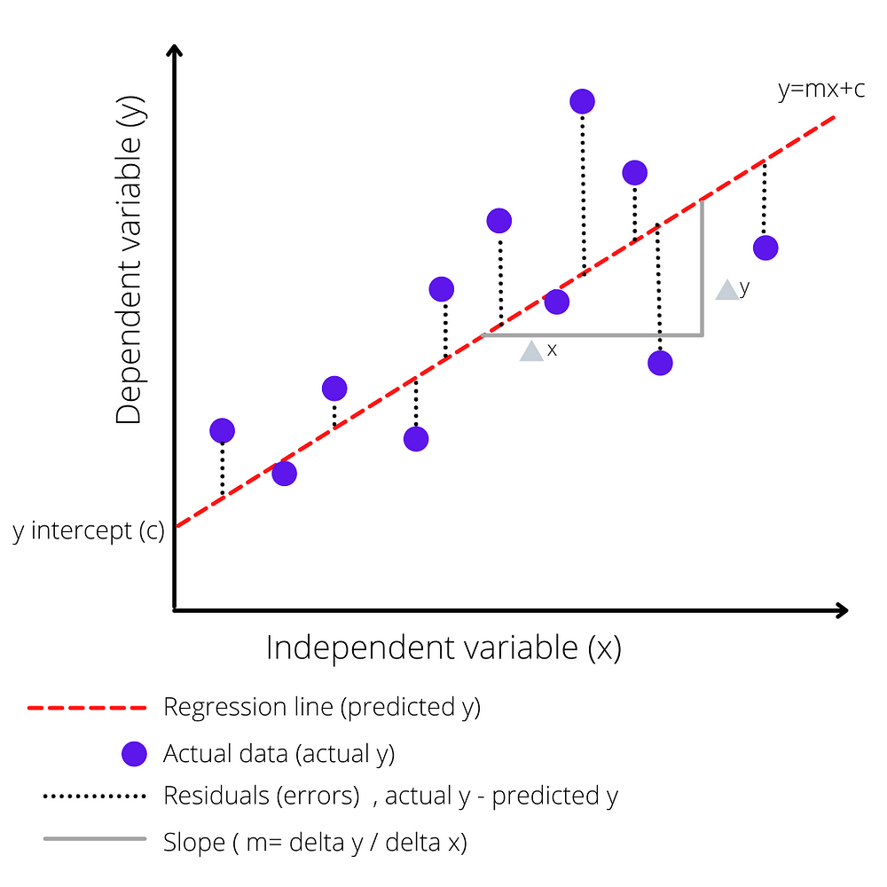
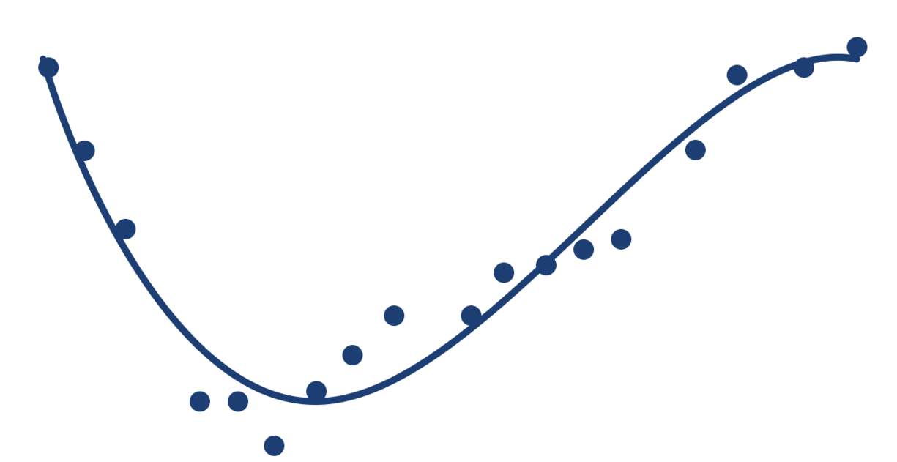
Linear, Multiple and Polynomial Regression
Linear Regression
Polynomial Regression
Please click on this Link for mathematical background:
Regression_derivation​

Slide 31
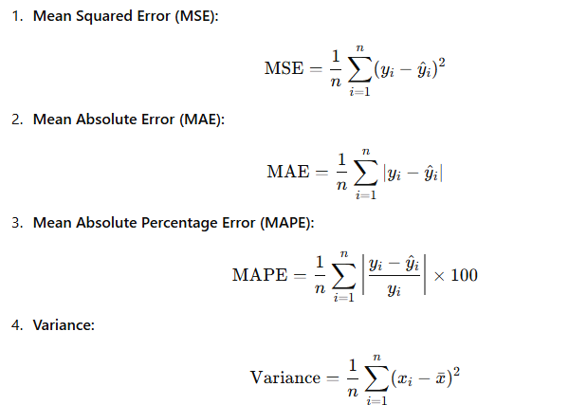
Evaluation
Train and test philosophy
Regression Metrics

Slide 32


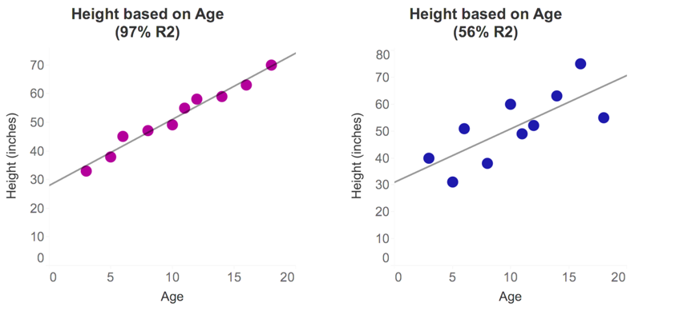
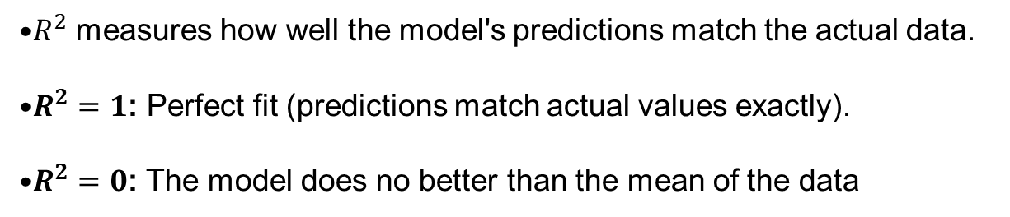
R^2
$R^{2}$ measures how well the model's predictions match the actual data.
$R^{2}=1$: Perfect fit (predictions match actual values exactly).
$R^{2}=0$: The model does no better than the mean of the data

Slide 33
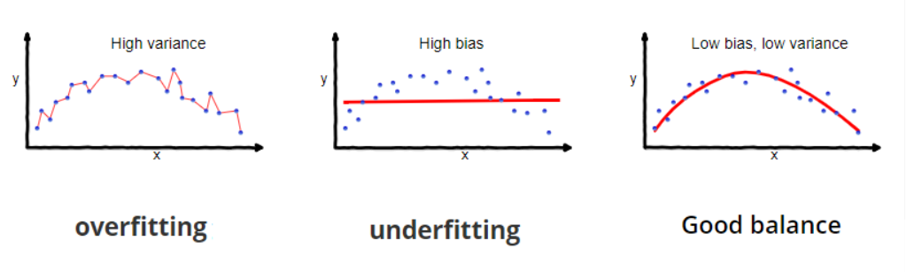
Overfitting vs Underfitting
Overfitting
The model learns the details and noise in the training data to the extent that it negatively impacts the performance of the model on new data.
Characteristics:
High variance, low bias
Perfect fit on training data, poor generalization to test data
The model is too complex (e.g., too many features, too high degree in polynomial regression).
Indicators:
High performance on training data
Poor performance on validation/test data
Underfitting
The model is too simple to capture the underlying patterns in the data, resulting in poor performance on both training and test data.
Characteristics:
High bias, low variance
Underperformance on both training and test data
The model is too simple (e.g., linear regression on non-linear data).
Indicators:
Poor performance on both training and test data

Slide 34
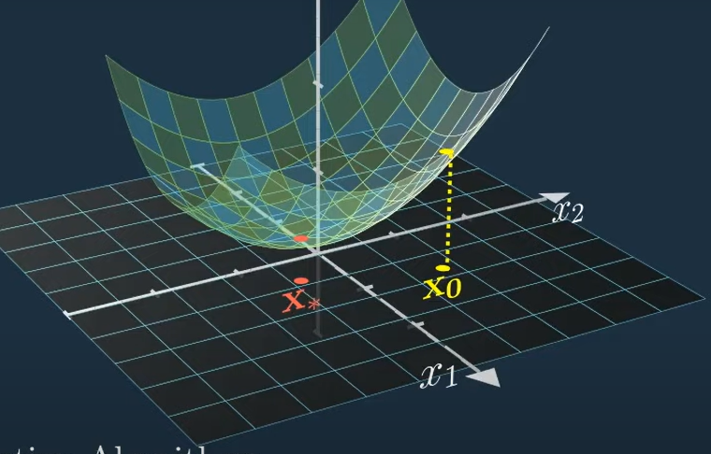


Slide 35
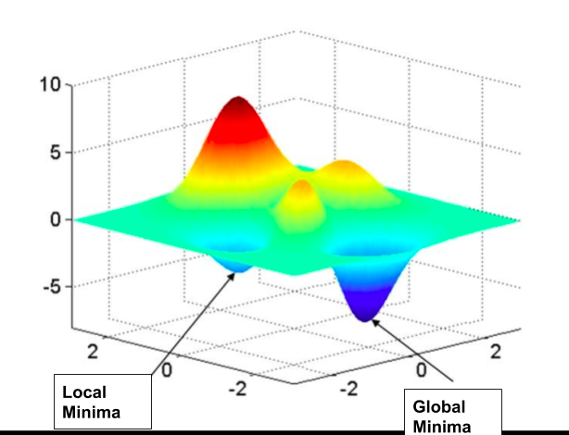
Optimization

